Slide 1

JEC CANTEEN APP
Under The Guidance of-
Dr. Dhruba Jyoti Baruah,
Associate Professor, MCA
Jorhat Engineering College, Jorhat
Prepared by- Meghna Dutta Pallab Saikia Pompi Basumatary
Preeti Devi Narzary Richad Yamin Ali

Slide 2
INTRODUCTION
The project “Mobile application for JEC canteen” is an online food ordering application built for the faculties of the college.
This application will help the canteen members and employees to manage their order and delivery online in a hassle-free way and keep track of the customer requirements.
The responsive UI will provide ease to the faculties to order their food and make payment.

Slide 3
Objectives
The objective of this project is to develop and design a Canteen application for the JEC faculties.
This canteen app will help the admin to manage the entire system by keeping eye on the food availability and customer’s account.
Our food ordering application enables ease for the customers by overcoming the traditional hustle and queuing system in front of the canteen.
This will help the admin not to sit and maintain the data manually.

Slide 4
ADVANTAGES of the App
Ensures Security of data.
Ensures data accuracy.
Proper control of the admin.
Minimized manual data entry.
Minimizing time needed for the various processing.
Greater efficiency and Better service.
User friendliness and interactive.
Fast execution of order and delivery process

Slide 5
Why Flutter and Firebase?
Because Flutter has -
Ready-made and custom widgets for fast UI coding
Dart – simple and effective language targeted at Java programmers
Hot reload function for instantaneous updates
Portable and platform-agnostic
Because Firebase has -
NoSQL
Cloud Firestore
Google Analytics
Real-Time Database

Slide 6
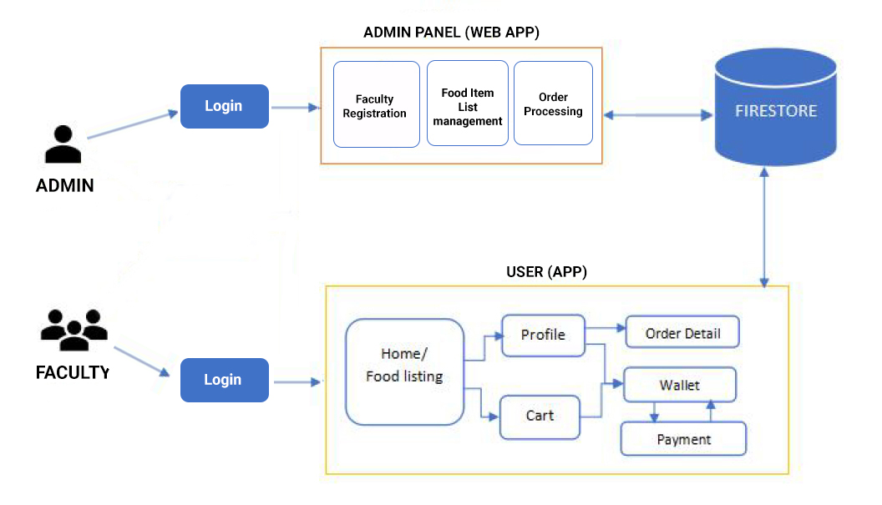
SYSTEM BACKGROUND

Slide 7
FUTURE SCOPE
Machine learning algorithms can be used for the prediction of the most preferred item by the customers.
Online payment and credit system can be implemented.
Advance Booking system can be implemented if food items are required in huge quantity for any event or occasion.
Customer’s feedback system can be integrated.
Alert system on food items availability can be integrated that will notify the admin to add/prepare more items which will minimize the manual observation.

Slide 8
CONCLUSION
We have reached the end of our project “JEC canteen app”. We would like to thank our project guide for whom we got this opportunity to learn flutter as well as other languages like PHP, JS etc in depth. Our whole team gained various concepts throughout the building of this project after immense hardwork.
We hope our online food ordering app becomes very beneficial to the faculties of our college and also for other colleges in coming days. We believe we can make better use of our app after integrating the new ideas in future.
Thank You

